Slide 1
BIZ06 – Bahasa Inggris 2

Slide 2
UNIT 7 Future Trends
Meeting 11

Slide 3
Specific Competence
Students are able to talk about future careers, future trends in educations in a college and university(C3)

Slide 4
1. Be going to and Will

Slide 5
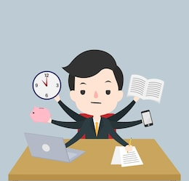
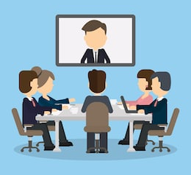

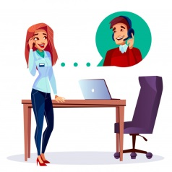
1.1 Be going to
to talk about plans or intentions:
Today, I am going to work from home,
then I am going to have video conference with my co-workers and finally I am going to phone my best friend.

Slide 6
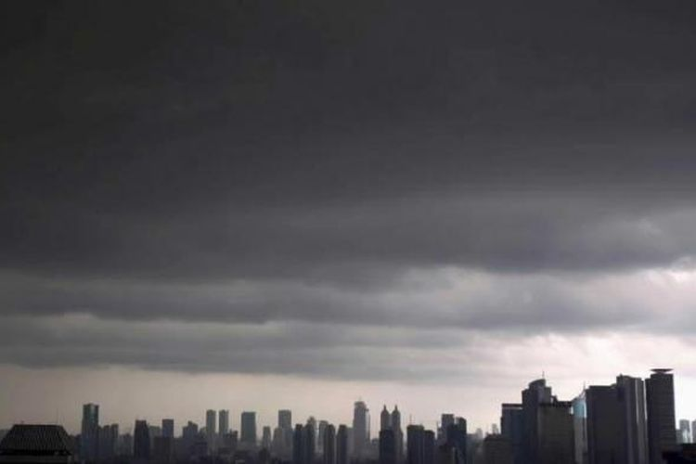
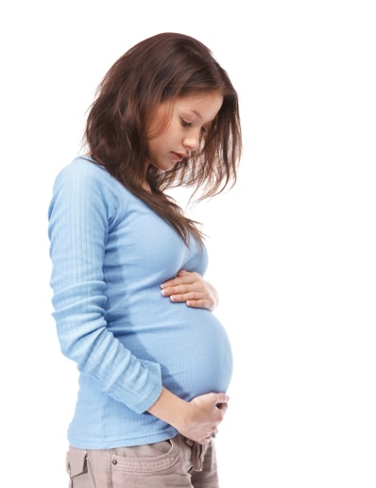
1.1 Be going to
to make predictions based on evidence we can see
Look at those black clouds!
It’s going to rain.
She is pregnant.
She is going to have a baby.

Slide 7
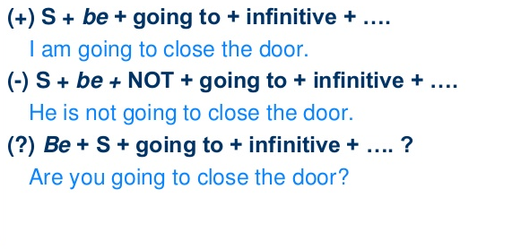
1.1 Be going to

Slide 8
1.2 Will
when we express beliefs about the future (without present evidence):
It will be a nice day tomorrow. I think Brazil will win the World Cup. I'm sure you will enjoy the film.
to talk about offers and promises:
Tim will be at the meeting. Mary will help with the cooking.

Slide 9
1.2 Will
to mean want to or be willing to:
I hope you will come to my party. George says he will help us.
to make offers and promises :
I'll see you tomorrow. We'll send you an email.

Slide 10
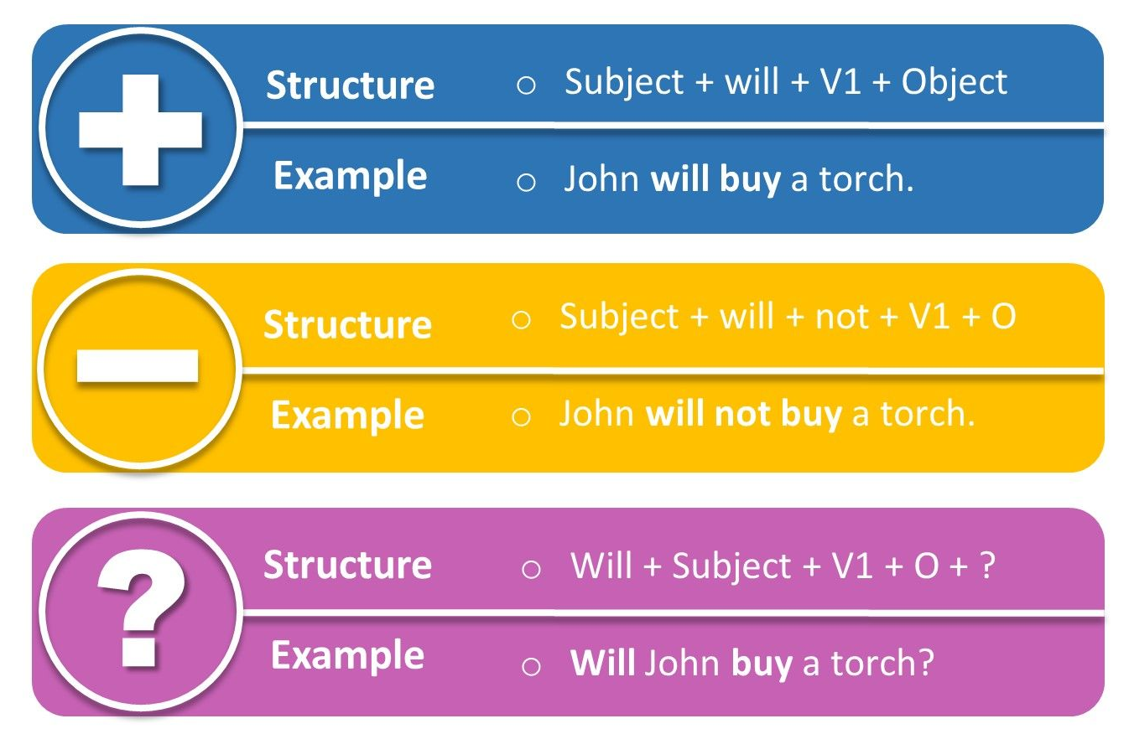
1.2 Will

Slide 11
Practice 1
Fill in the blanks with “will” or “be going to” 1. Have you got any plans for tomorrow? Yes, _____ visit my grandparents.
2. Why is she learning Spanish? She _____ travel to Spain.
3. We are thirsty. Wait here. I _____ get some water.
4. Meat or fish? I _____ have some fish, please.
5. What do you want the keys for? I _____ close the door.
6. If you don't take a taxi, you _____ arrive on time.
7. Why do you want so many oranges? I _____ make an orange juice.
8. Oh! I haven't got enough money to pay! Don't worry. I _____ lend you some.
9. We need one more player. _____ you _____ (play) with us tomorrow?
10. Why are you switching on the TV? I _____ watch a football match.

Slide 12
2. Vocabulary

Slide 13
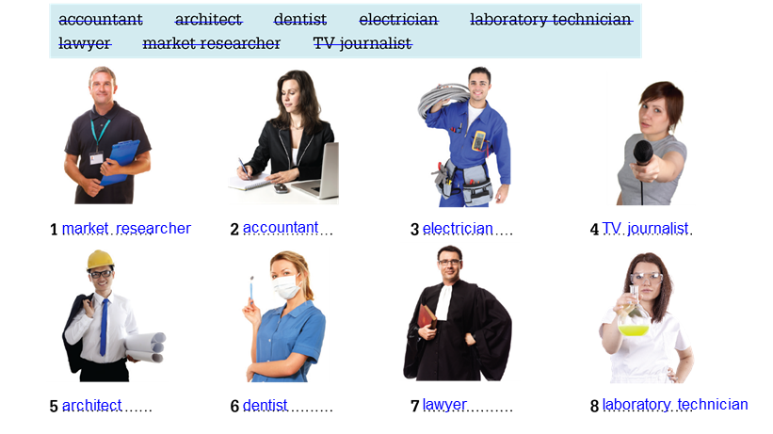
Work and Job

Slide 14
Preposition: at, for, in, on
We use work at followed by a place or a task:
Jack works at a bank downtown.
The boss was working at his desk all day.
I had a problem with my computer and I was working at it for a few hours until it was solved.

Slide 15
Preposition: at, for, in, on
We use work for followed by a company, a cause or a person:
➔Jack works for NYC Finance downtown.
Jenny has been working for animal rights all her life.
Teddy used to work for Jack Welch.

Slide 16
Preposition: at, for, in, on
We use work in followed by a field or industry:
Jack works in finance.
I’ve been working in international education for more than 20 years.

Slide 17
Preposition: at, for, in, on
We use work on followed by a task:
Jack works on finance reports for the bank.
I was working on my lessons all morning.

Slide 18
Practice 2
Open page 60 to answer questions in part G.

Slide 19
3. Listening Activity

Slide 20

Practice 3
Play audio file track 33 on page 55 part A and B to answer the questions.

Slide 21
Thank You

